Slide 1
Data Structures & Algorithms
Lecture : 04

Slide 2
Sorting Algorithms

Slide 3
Some Definitions
Sorting
  Is a process that organizes a collection of data into either ascending or descending order
Internal Sort
  The data to be sorted is all stored in the computer’s main memory.
External Sort
  Some of the data to be sorted might be stored in some external, slower, device.
In Place Sort
  The amount of extra space required to sort the data is constant with the input size.

Slide 4
Sorting
  We will analyze only internal sorting algorithms.
  Sorting also has indirect uses. An initial sort of the data can significantly enhance the performance of an algorithm.
  Majority of programming projects use a sort somewhere, and in many cases, the sorting cost determines the running time.
  It is estimated that 25~50% of all computing power is used for sorting activities.
Notes:
Sorting is not just about arranging data; it can enhance the efficiency of other algorithms. Some examples:
✅ Binary Search Works Faster on Sorted Data
If a dataset is sorted, we can use Binary Search (O(log n)) instead of Linear Search (O(n)), making searching much faster.
✅ Sorting Helps in Duplicate Removal
If you sort a list first, removing duplicates becomes easier.
Example: After sorting, just check adjacent elements to remove duplicates in O(n).

Slide 5
Sorting Applications
  Common problem: sort a list of values, starting from lowest to highest.
    Example: Sorting {7, 3, 5, 1, 9} into {1, 3, 5, 7, 9}.
  To prepare a list of student ID, names, and scores in a table (sorted by ID or name) for easy checking.
  To prepare a list of scores before letter grade assignment.
  To produce a list of horses after a race (sorted by the finishing times) for payoff calculation.

Slide 6
Sorting Applications…
  To prepare an originally unsorted array for ordered binary searching.
  List of exam scores (Sorting helps to find top students, to find lowest scores and to find median scores).
  Words of dictionary in alphabetical order
  Generally, we are given a list of records that have keys. These keys are used to define an ordering of the items in the list.
  Keys are unique identifiers (e.g., student ID, employee number, product ID).

Slide 7
C++ Implementation of Sorting
  Use C++ templates to implement a generic sorting function.
  This would allow use of the same function to sort items of any class.
  However, class to be sorted must provide the following overloaded operators:
    Assignment: =
    Ordering: >, <, ==
  In this lecture, we’ll talk about sorting integers; however, the algorithms are general and can be applied to any class as described above.

Slide 8
Sorting Algorithms
There are many sorting algorithms, such as:
  Selection Sort
  Insertion Sort
  Bubble Sort
  Merge Sort
  Quick Sort
The first three are the foundations for faster and more efficient algorithms.

Slide 9
Selection Sort
Selection sort is a simple sorting algorithm. It works by first finding the smallest element using a linear search and swapping it into the first position in the list,
Then finding the second smallest element by scanning the remaining elements, and so on.
Selection sort is unique compared to almost any other algorithm in that its running time is not affected by the prior ordering of the list, it performs the same number of operations because of its simple structure.
A list of n elements requires n-1 passes to completely rearrange the data.

Slide 10
Unsorted
23 | 78 | 45 | 8 | 32 | 56
8 | 78 | 45 | 23 | 32 | 56
8 | 23 | 45 | 78 | 32 | 56
8 | 23 | 32 | 78 | 45 | 56
8 | 23 | 32 | 45 | 78 | 56
8 | 23 | 32 | 45 | 56 | 78
Original List
After pass 1
After pass 2
After pass 3
After pass 4
After pass 5

Slide 11
Selection Sort
// Template function for Selection Sort
template <typename T>
void selectionSort(T arr[], int n) {
for (int i = 0; i < n - 1; i++) {
int minIndex = i;
for (int j = i + 1; j < n; j++) {
if (arr[j] < arr[minIndex]) {
minIndex = j;
}
}
// Swap elements
if (minIndex != i) {
T temp = arr[i];
arr[i] = arr[minIndex];
arr[minIndex] = temp;
}
}
}

Slide 12
Selection Sort
template <typename T>
void printArray(T arr[], int n) {
for (int i = 0; i < n; i++) {
cout << arr[i] << " ";
}
cout << endl;
}
int main() {
int intArr[] = {5, 2, 9, 1, 5, 6};
int n = sizeof(intArr) / sizeof(intArr[0]);
cout << "Before sorting (integers): ";
printArray(intArr, n);
selectionSort(intArr, n);
cout << "After sorting (integers): ";
printArray(intArr, n);
return 0;
}

Slide 13
Insertion Sort
Insertion sort is a simple sorting algorithm that is appropriate for small inputs.
  Most common sorting technique used by card players.
Step 1: The second element of an array is compared with the elements that appears before it (only first element in this case). If the second element is smaller than first element, second element is inserted in the position of first element. After first step, first two elements of an array will be sorted.

Slide 14
Insertion Sort
Step 2: The third element of an array is compared with the elements that appears before it (first and second element). If third element is smaller than first element, it is inserted in the position of first element. If third element is larger than first element but, smaller than second element, it is inserted in the position of second element. If third element is larger than both the elements, it is kept in the position as it is. After second step, first three elements of an array will be sorted.
Step 3: Similarly, the fourth element of an array is compared with the elements that appears before it (first, second and third element) and the same procedure is applied and that element is inserted in the proper position.
If there are n elements to be sorted. Then, this procedure is repeated n-1 times to get sorted list of array.

Slide 15
Insertion Sort
Sorting a hand of playing cards
  Start with an empty left hand and the cards facing down on the table.
  Remove one card at a time from the table, and insert it into the correct position in the left hand
    compare it with each of the cards already in the hand, from right to left
  The cards held in the left hand are sorted
    these cards were originally the top cards of the pile on the table

Slide 16
Insertion Sort
To insert 12, we need to make room for it by moving first 36 and then 24.
6
10
24
36
12

Slide 17
Insertion Sort
6
10
24
36
12

Slide 18
Insertion Sort
6
10
24
36
12

Slide 19
Sorted
Unsorted
23 | 78 | 45 | 8 | 32 | 56
23 | 78 | 45 | 8 | 32 | 56
23 | 45 | 78 | 8 | 32 | 56
8 | 23 | 45 | 78 | 32 | 56
8 | 23 | 32 | 45 | 78 | 56
8 | 23 | 32 | 45 | 56 | 78
Original List
After pass 1
After pass 2
After pass 3
After pass 4
After pass 5

Slide 20
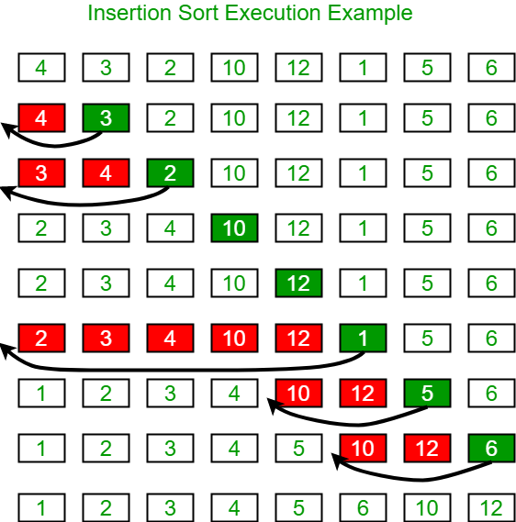

Slide 21
Insertion Sort Algorithm
// Template function for Insertion Sort
template <typename T>
void insertionSort(T arr[], int n) {
for (int i = 1; i < n; i++) {
T key = arr[i]; // Store the current element
int j = i - 1;
// Move elements that are greater than key one position ahead
while (j >= 0 && arr[j] > key) {
arr[j + 1] = arr[j];
j--;
}
arr[j + 1] = key; // Insert the element in the correct position
}
}

Slide 22
Bubble Sort
Bubble sort, sometimes incorrectly referred to as sinking sort, is a simple sorting algorithm that works by repeatedly stepping through the list to be sorted, comparing each pair of adjacent items and swapping them if they are in the wrong order.
The pass through the list is repeated until no swaps are needed, which indicates that the list is sorted.
Each time an element moves from the unsorted part to the sorted part one sort pass is completed.

Slide 23
Bubble Sort…
Given a list of n elements, bubble sort requires up to n-1 passes to sort the data.
Smaller elements "bubble" to the top of the list. Because it only uses comparisons to operate on elements, it is a comparison sort.

Slide 24
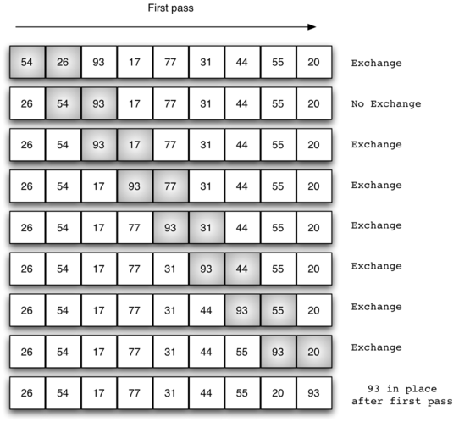
Bubble Sort

Slide 25
Bubble Sort Algorithm
template <typename T>
void bubleSort(T arr[], int n)
{
for (int i = 0; i < n-1; i++)
{
for (int j=0; j < n-i-1; j++)
{
if (arr[j] > arr[j+1])
{
T temp = arr[j+1];
arr[j+1] = arr[j];
arr[j] = temp;
}
}
}
}

